Slide 1
Senior Project
Aralee Fajardo; Class of 2012.

Slide 2
Agenda
Introduction
Research
Action
of the Presentation.

Slide 3
Introduction
in Detail. Research Question.
"How does Promotions and Advertising Negatively Affect the Global Society Today?"

Slide 4
Ear
Sight
Introduction
Touch
in Research.
"How does Promotions and Advertising Negatively Affect the Global Society Today?"

Slide 5
"How does Promotions and Advertising Negatively Affect the Global Society Today?"
Internal
Health
Introduction
Economical
in Research.

Slide 6
Topics
Asia
Europe
North America

Slide 7
Research
Topics in Detail
United States
Children and Adolescents
Gender Stereotypes
Europe
Czech Dream
The Advertising Industry in the EU
Asia
Japan’s Youth Fashion
South Korea’s Aesthetic Surgery
Lower Voter Turnouts
China’s Counterfeit Goods

Slide 8
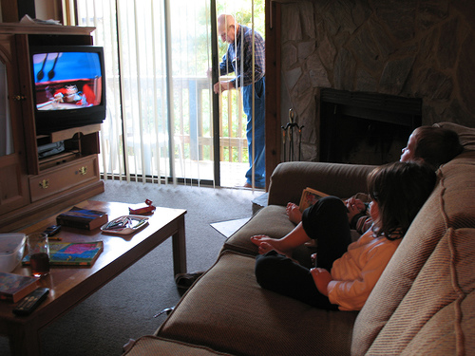
United States
“Children and Adolescents”
Overall Ad Tactic: Product Placement
School
Home
Outside Food Chains

Slide 9
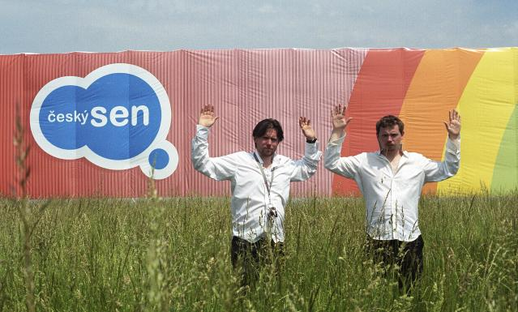
Europe
“Czech Dream”
“Money and Looks”
Czech Republic
Two Film Students
Embezzled Tax Money
Fake Hypermarket

Slide 10
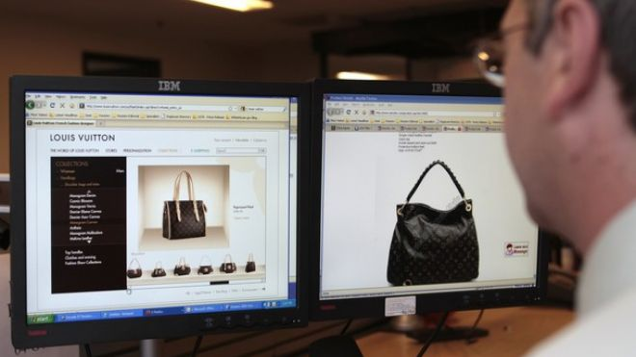
Asia
“China’s Counterfeit Goods”
Buyers and Workers
Product Placement
Fraud
Unsafe Work Conditions
IPR Seizures

Slide 11
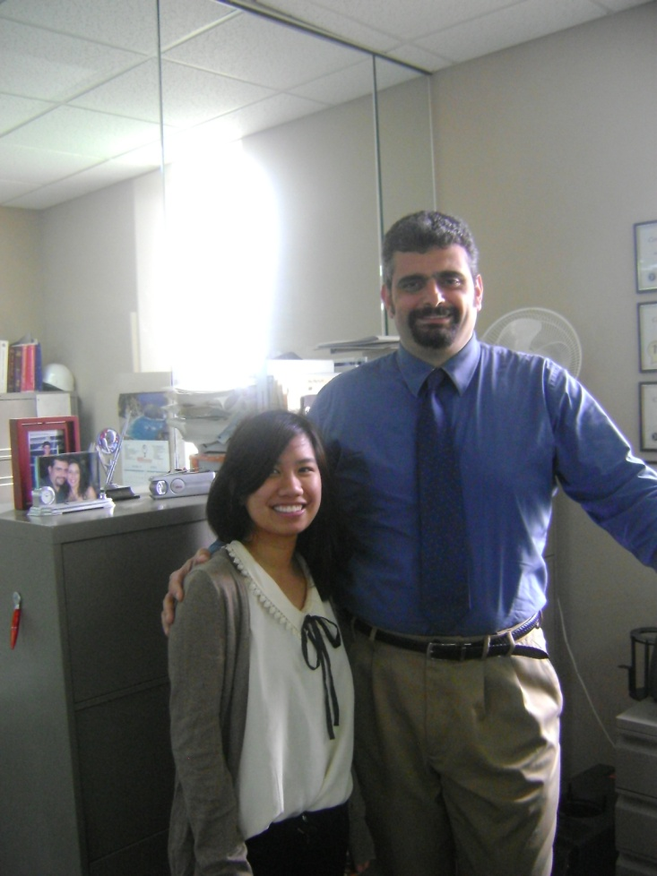
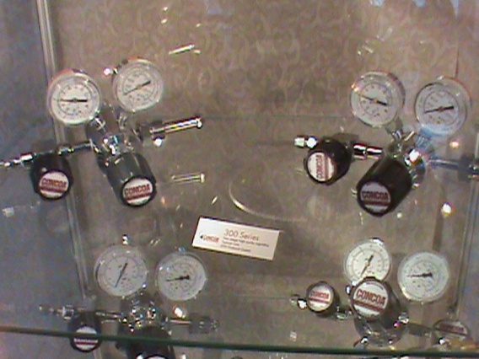
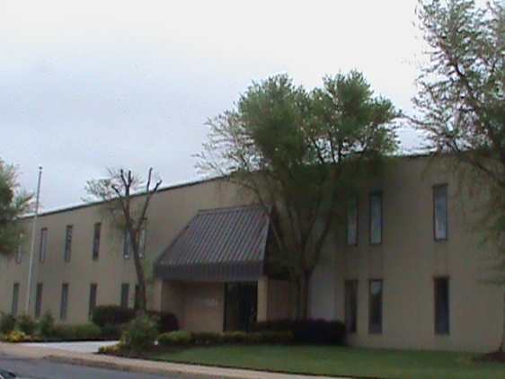
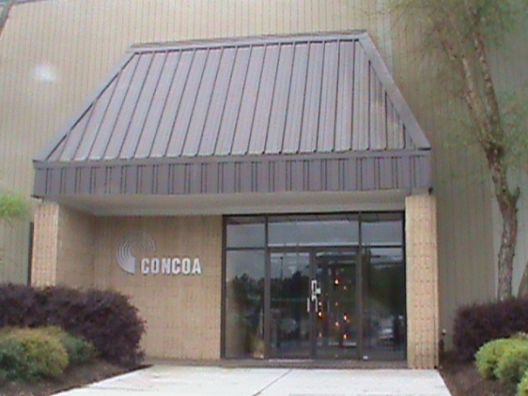
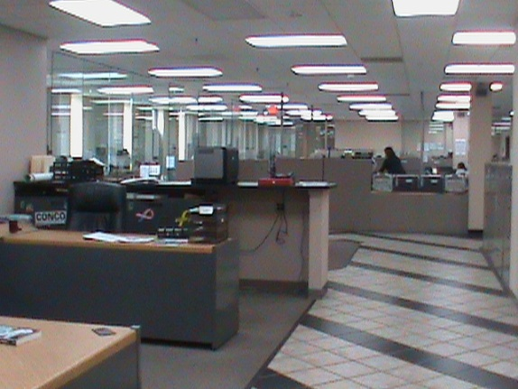
Internship
in Action.
Giorgio Valentini – Creative Marketing Specialist
Controls Corporation of America

Slide 12
Event
in Action.
International Bible Baptist Church.
Project Presentation & Survey.

Slide 13
Thank You.
and have a nice day.

