Slide 1
Senior Project
Aralee Fajardo; Class of 2012.

Slide 2
Agenda
Introduction
Research
Action
of the Presentation.

Slide 3
Introduction
in Detail. Research Question.
"How does Promotions and Advertising Negatively Affect the Global Society Today?"

Slide 4
Topics
Asia
Europe
North America

Slide 5
Research
Topics in Detail
United States
Children and Adolescents
Gender Stereotypes
Europe
Czech Dream
The Advertising Industry in the EU
Asia
Japan’s Youth Fashion
South Korea’s Aesthetic Surgery
Lower Voter Turnouts
China’s Counterfeit Goods

Slide 6
United States
“Gender Stereotypes”
Men’s Men
Women’s Men
Women’s Women
Women’s Men
Four types of Gender commercials in America:

Slide 7
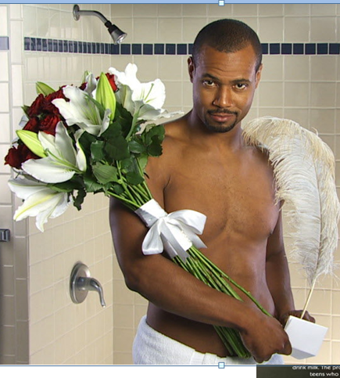
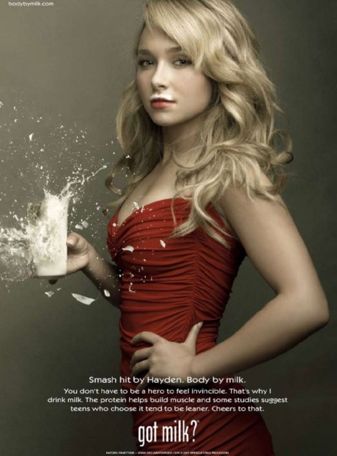
United States
“Gender Stereotypes”

Slide 8
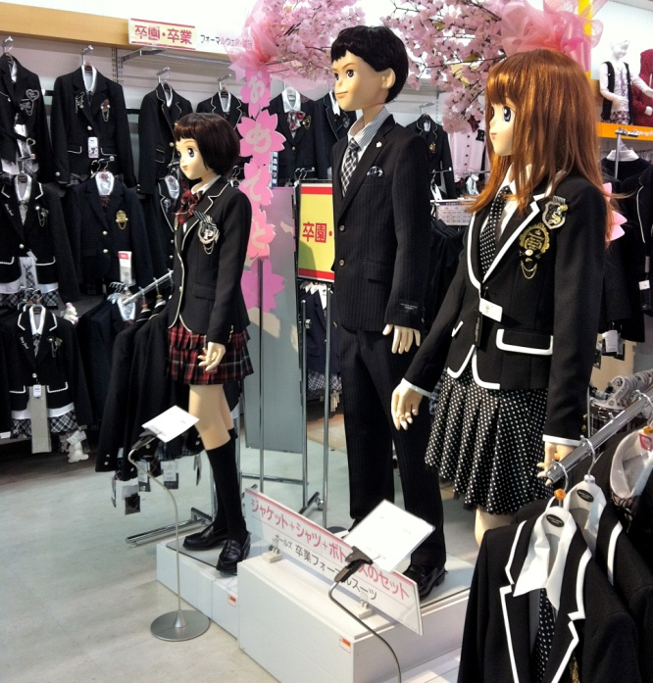
Asia
“Japan’s Youth Fashion”
Actions based on Influence
Surgery
“shikikata ga nai”
Cutting and pulling up uniform skirts
Music
J-POP
Anime
Manga
Influence

Slide 9
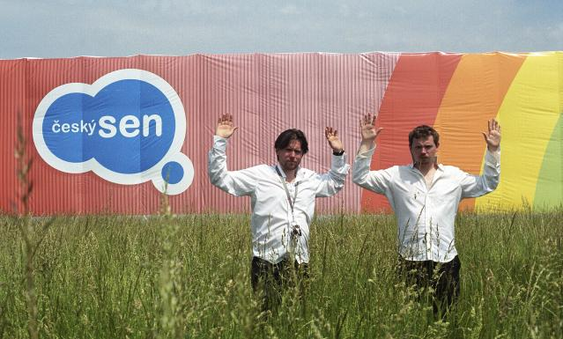
Europe
“Czech Dream”
“Money and Looks”
Czech Republic
Two Film Students
Embezzled Tax Money
Fake Hypermarket

Slide 10
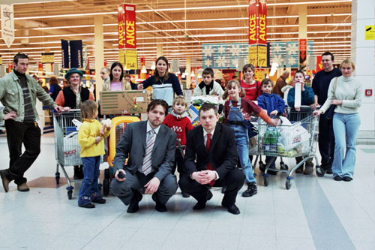
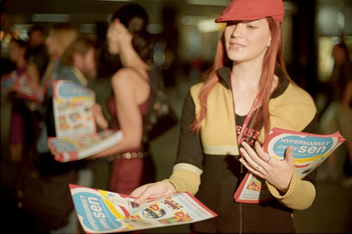
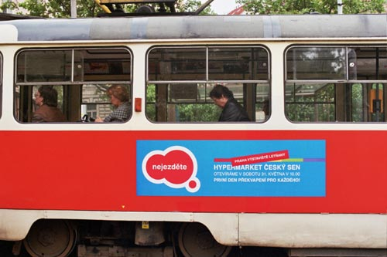
Europe
“Czech Dream”

Slide 11
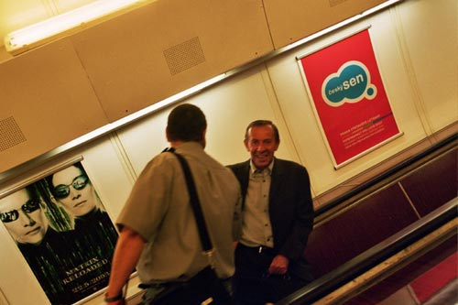
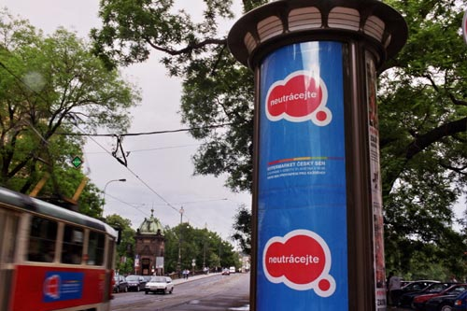
Europe
“Czech Dream”

Slide 12
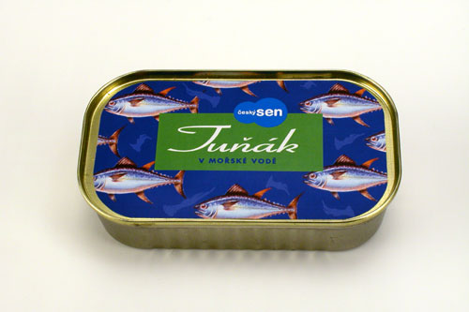
Europe
“Czech Dream”

Slide 13
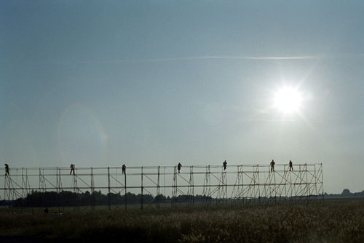
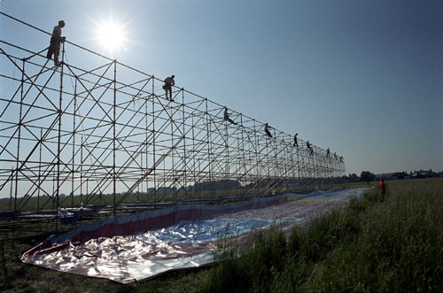
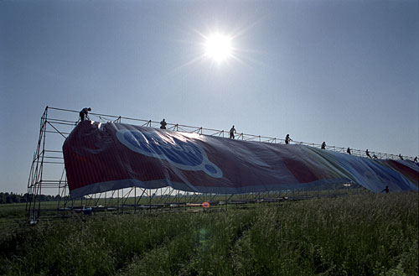
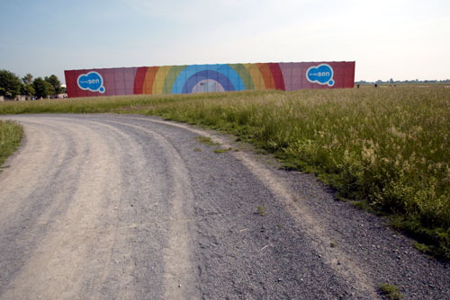
Europe
“Czech Dream”

Slide 14
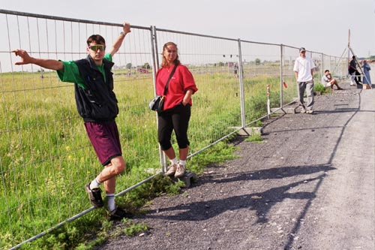
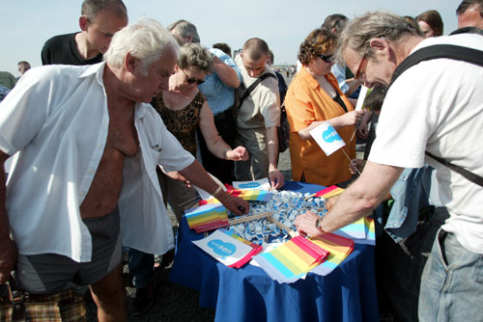
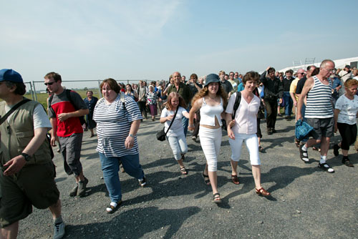
Europe
“Czech Dream”

Slide 15
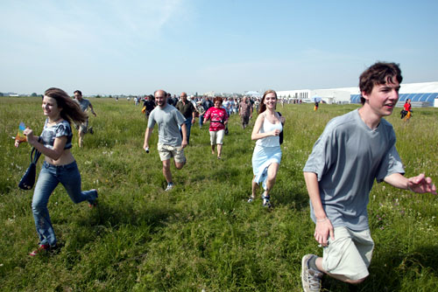
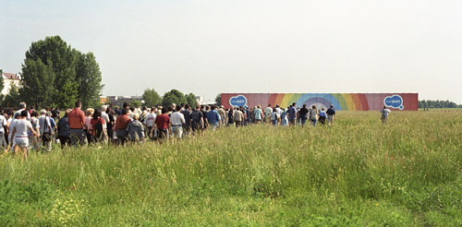
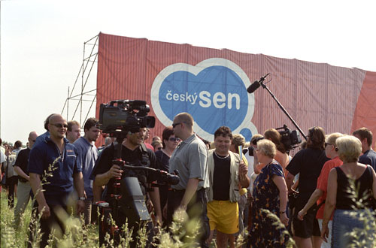
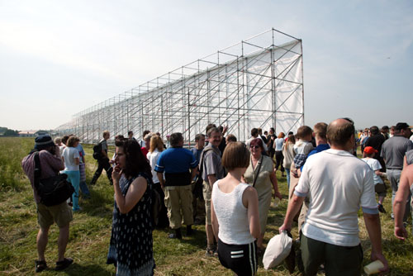
Europe
“Czech Dream”

Slide 16
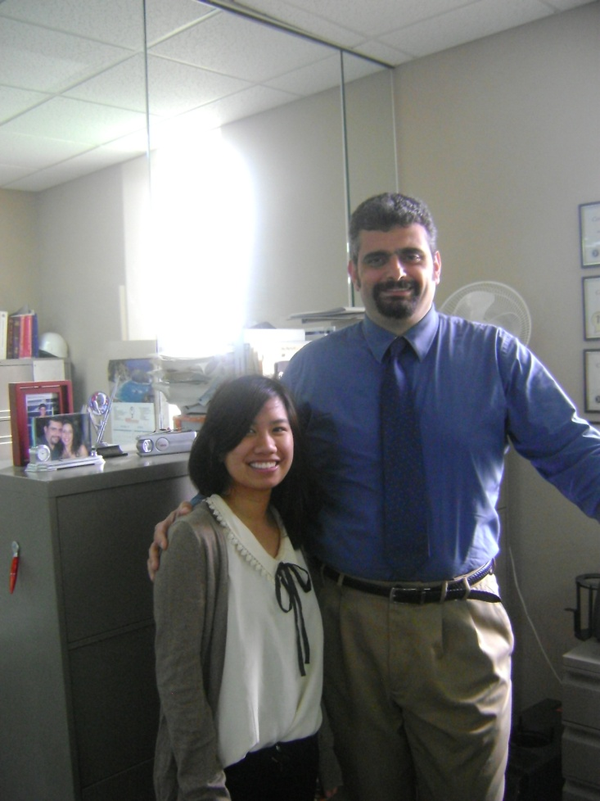
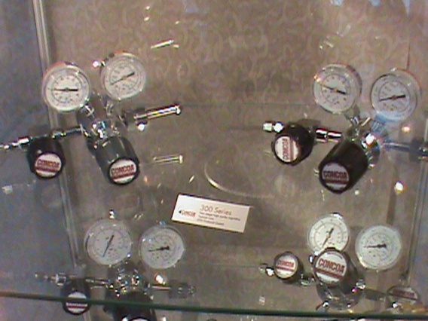
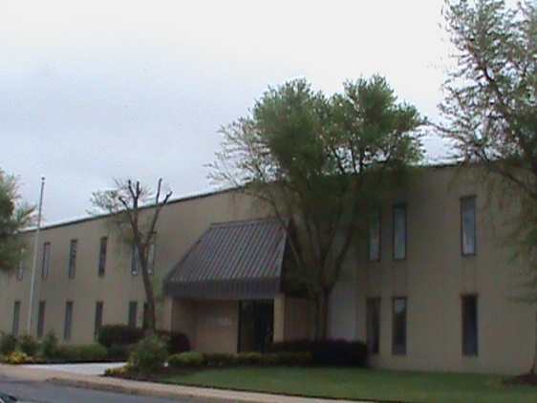
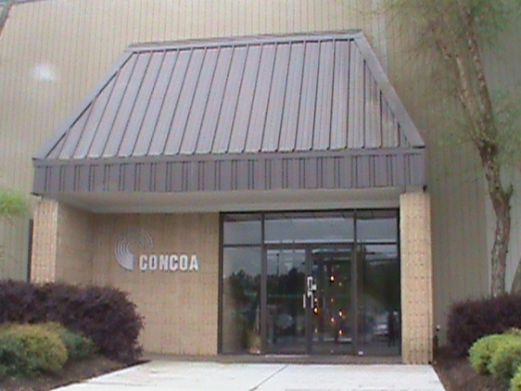
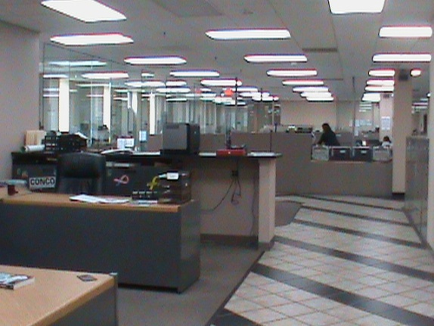
Internship
in Action.
Giorgio Valentini – Creative Marketing Specialist
Controls Corporation of America

Slide 17
“How can you increase a 1% profit margin in our company?”
Internship
in Action.

Slide 18
Event
in Action.
International Bible Baptist Church.
Project Presentation & Survey.

Slide 19
Thank You,
and have a nice day!

