Slide 1
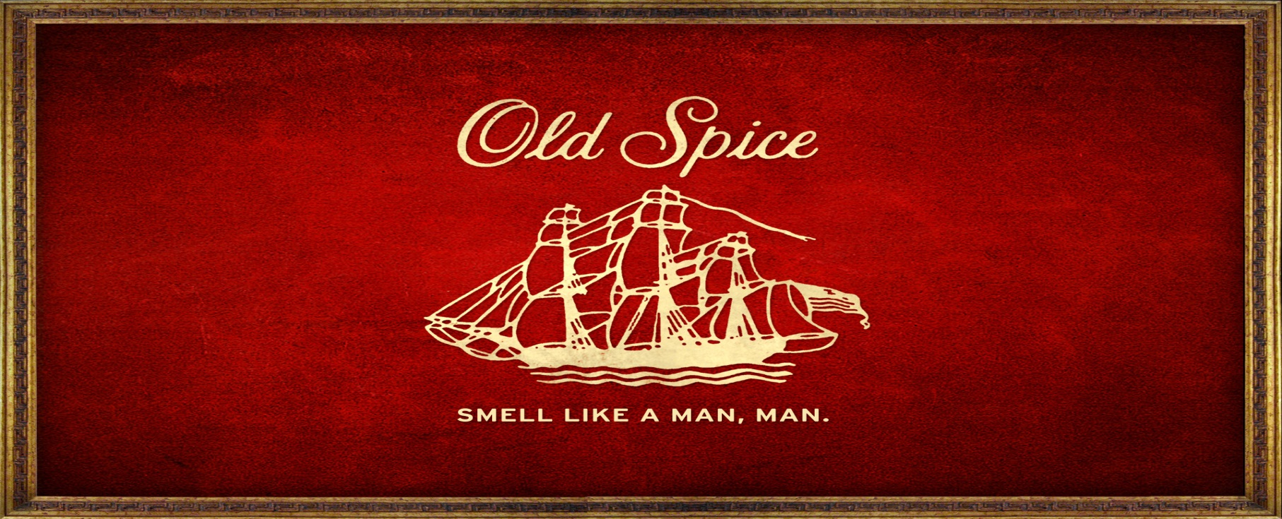
Old Spice
Aralee Fajardo & Seanna Espinoza
3.2.12
4A

Slide 2
About Old Spice
“Smell like a Man, Man!”
One of the most popular brand of deodorant and body wash
On the shelves since 1938 (74 years!)
Old Spice had long been associated with the past and elderly gentlemen
Associated with the color red and black & a sail boat
Old Spice got its name from a spice jug

Slide 3
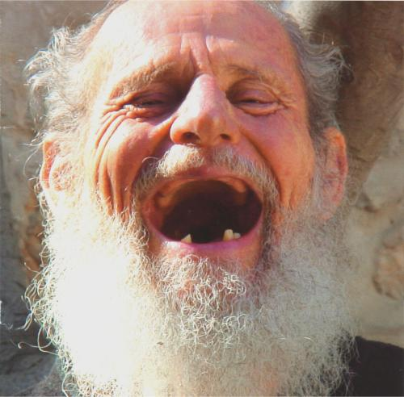
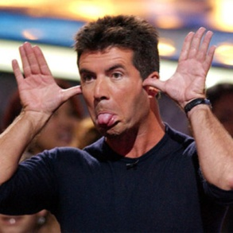
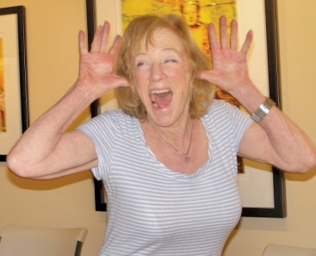
Appealing Targets
Directly - BEFORE Older gentlemen, but NOW for male Adolescents and men between the ages of 12 to 34
Indirectly - Women
p
p

Slide 4
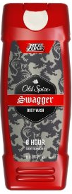
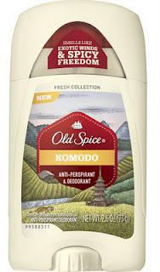
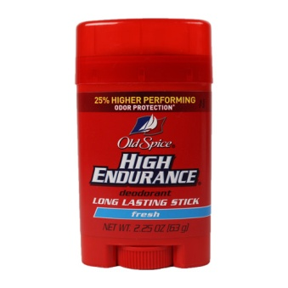
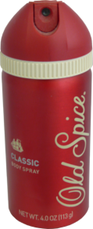
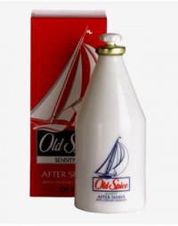
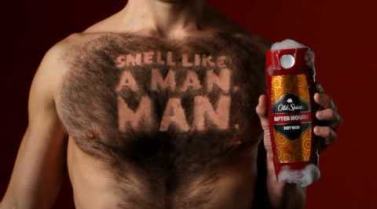
A brief Timeline
Shulton Company 1937-1938
Procter & Gamble 1990 - now
Smell like a Man, Man. Campaign 2008

Slide 5
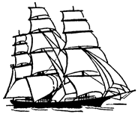
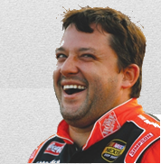
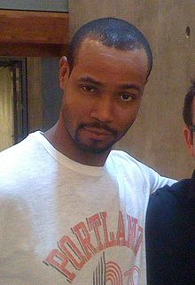
A line of Significant Changes
"The original. If your grandfather hadn't worn it, you wouldn't exist."
Smell like a Man, Man.
Clipper Ship
Yacht
Slogan 2008
Logo 1998
Famous Celebrities
Isaiah Mustafa
Representative
Minor
Major and Shorten
Cathy Whistle Jingle
Tony Stewart
Notes:
Isaiah Mustafa – American Actor and NFL practice squad wide receiver.

Slide 6
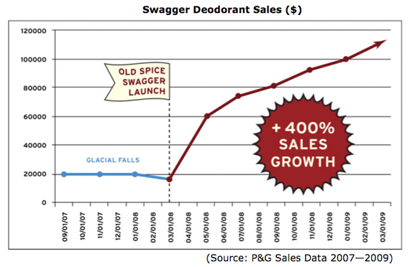
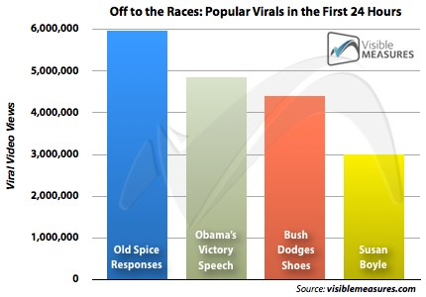
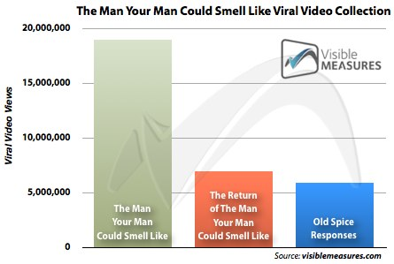
Advertising Campaign

Slide 7
Advertising Campaign
Mainly Paper Ads and YouTube Videos
Costed $6,000,000
Started Early June 2008 to 2010
Created by Wieden+ Kennedy
Notes:
Smell like a Man, Man OR The Man Your Man Could Smell Like. Wieden+Kennedy - private company mad by 2 guys in Portland, Oregon. Known for working with Nike.

Slide 8
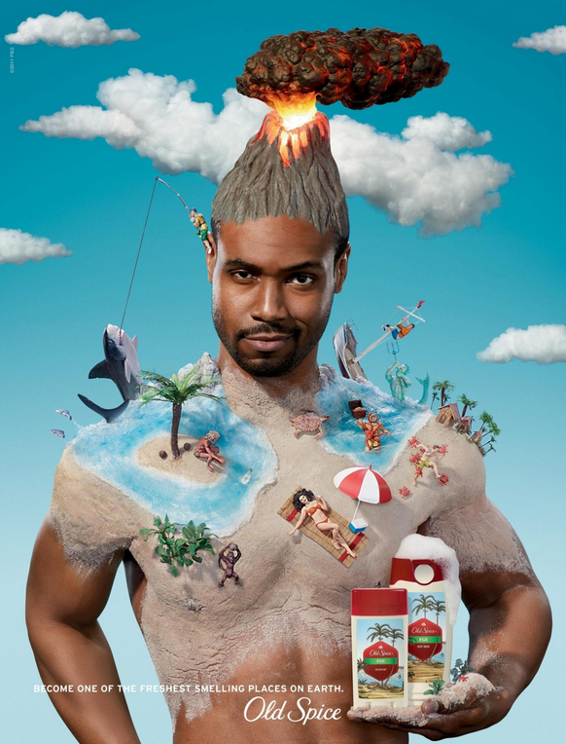
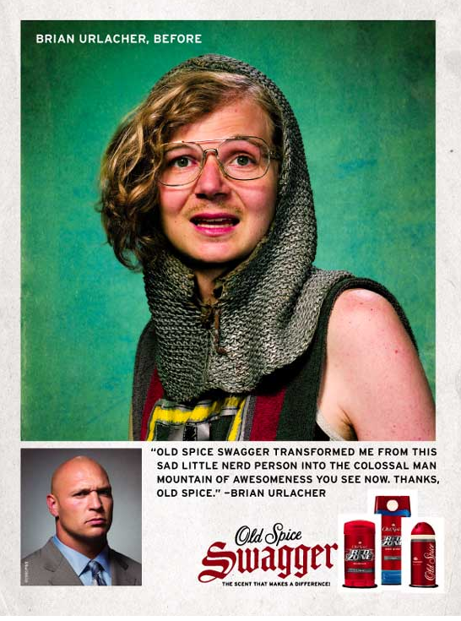
Awesome Ads

Slide 9
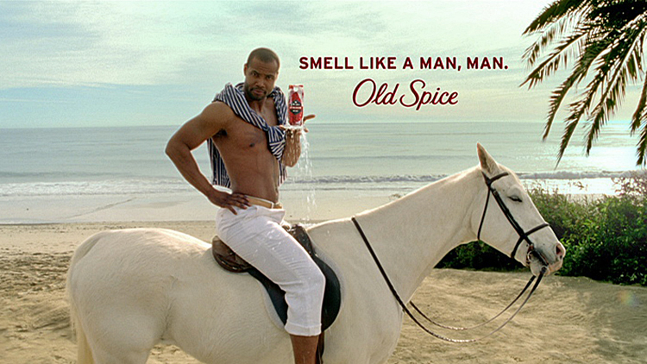
Ads & YouTube Commercials
http://www.youtube.com/watch?v=owGykVbfgUE&feature=player_embedded
http://www.youtube.com/watch?v=5Ziwz5Ltn-w&feature=related
http://www.youtube.com/watch?v=i-vQRT3bEmI
http://www.youtube.com/watch?v=HAJ3fdYIxXU
http://www.youtube.com/watch?v=_-fLV28SkZ8
http://www.youtube.com/watch?v=uLTIowBF0kE

Slide 10
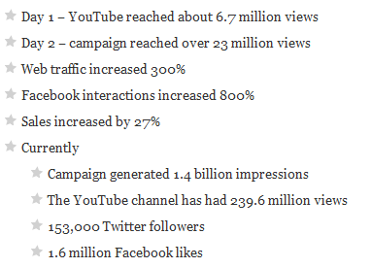
A list of Strengths and Weakness
Cathy, comprehendible, humorous, appealing to all masses, attractive, accessible, convenient
None – only past campaigns had flaws

Slide 11
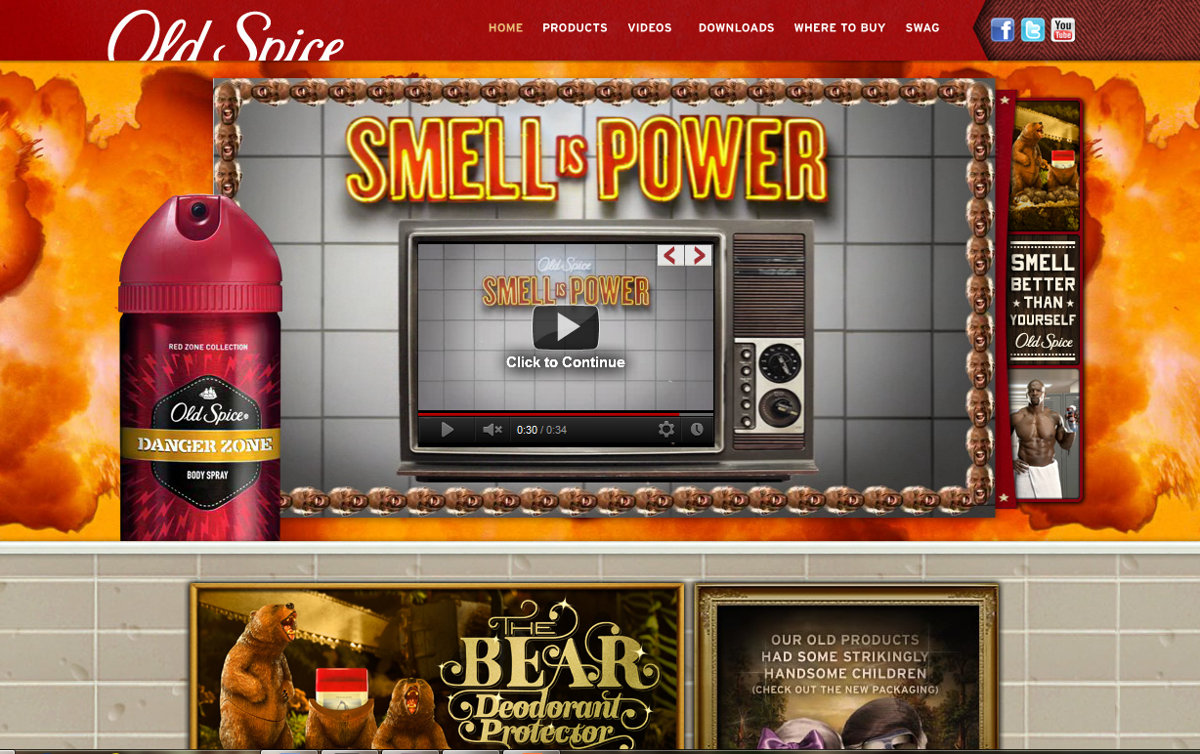
A Sexy Website
http://www.oldspice.com/

Slide 12
Advantage of Competition
Increase sales by 30% with all fragrance lines through social media.
Mainly markets to younger audiences. (humorous and connected to a younger crowd)
Having Isaiah Mustafa
HUGE SUCCESS hoho~
Attractive looking products
Company already successful

Slide 13
All our Citations
Cohen, Ryan W. “Why the Old Spice Campaign Succeeded: 7 Reasons You Didn’t Know.” Bostlnno. N.p., 10 Mar. 2011. Web. 29 Feb. 2012. <http://bostinno.com/‌2011/‌03/‌10/‌why-the-old-spice-campaign-succeeded-7-reasons-you-didn%E2%80%99t-know/>.
Grobbel, Allison Ann. “Old Spice ‘The Man Your Man Could Smell Like.’” New Media. N.p., 18 July 2011. Web. 1 Mar. 2012. <http://newmediadl.cas.msu.edu/‌homework/‌227/‌64544>.
Kimmel, A J. “P&G Connects With Old Spice Campaign.” Connections with the Consumers. N.p., 18 July 2010. Web. 29 Feb. 2012. <http://www.connectingwithconsumers.net/‌index.php?post/‌2010/‌07/‌18/‌PG-Connects-With-Old-Spice>.
Norton, Mike. “Old Spice - P&G Latest Innovations .” P&G. N.p., 2010. Web. 1 Mar. 2012. <http://www.pg.com/‌en_US/‌downloads/‌innovation/‌factsheet_OldSpice.pdf>.
Real, Chrissy. “OLD spice takes a NEW direction.” BloggerUniversity. N.p., 27 Sept. 2011. Web. 1 Mar. 2012. <http://bloggeruniversity.wordpress.com/‌2011/‌09/‌27/‌old-spice-takes-a-new-direction/>.
Social Times. “How Old Spice Swaggerized Their Brand And Men Everywhere.” Social Times. N.p., 22 July 2010. Web. 29 Feb. 2012. <http://socialtimes.com/‌how-old-spice-swaggerized-their-brand-and-men-everywhere_b18042>.

