Slide 1
Senior Project
Aralee Fajardo; Class of 2012.

Slide 2
Agenda
Introduction
Research
Action
of the Presentation.

Slide 3
Introduction
Aspiration
in Detail.
Biography of Myself
Tallwood High School Academy
Preparation
Community

Slide 4
International Business
Research
Internet
in Detail – Research Question.
Graphic Design
"How does Promotions and Advertising Negatively Affect the Global Society Today?"

Slide 5
"How does Promotions and Advertising Negatively Affect the Global Society Today?"
Research
in Detail.
Internal
Health
Economical

Slide 6
"How does Promotions and Advertising Negatively Affect the Global Society Today?"

Slide 7
Topics
Asia
Europe
America

Slide 8
Topics in Detail
America
Children and Adolescents
Gender Stereotypes
Europe
Czech Dream
The Advertising Industry in the EU
Asia
Japan’s Youth Fashion
South Korea’s Aesthetic Surgery
Lower Voter Turnouts
Sexual Marketing of Eastern Europe
China’s Counterfeit Goods

Slide 9
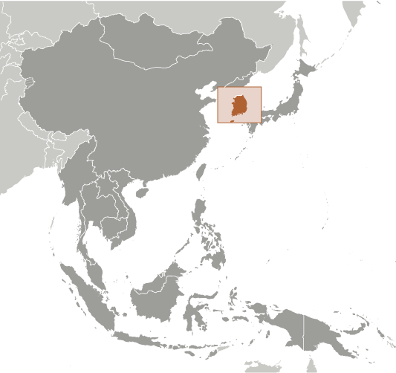
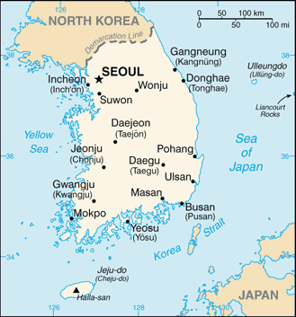
South Korea
in Detail.

Slide 10
Action!
HYBRID

Slide 11
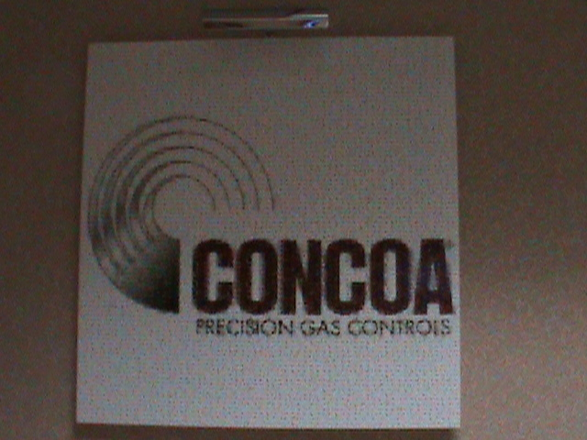
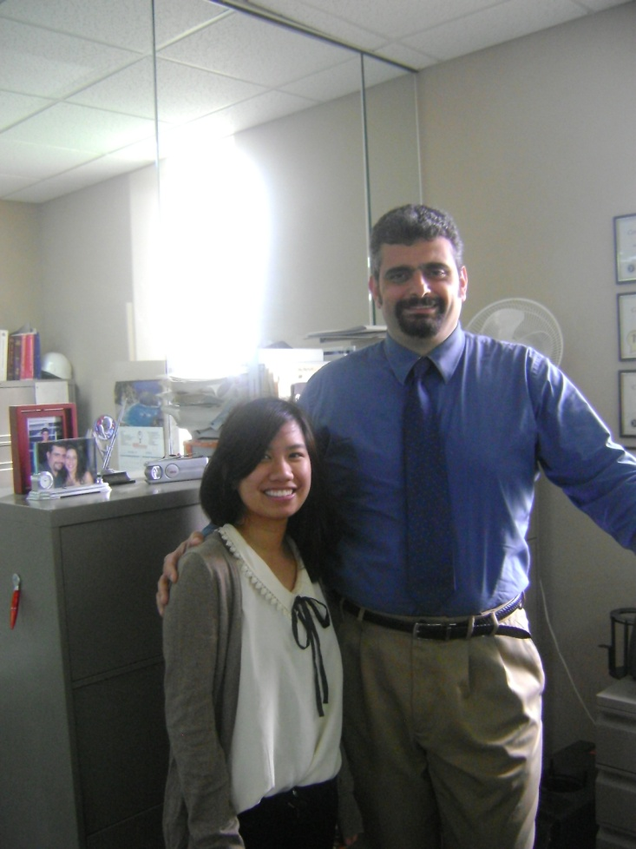
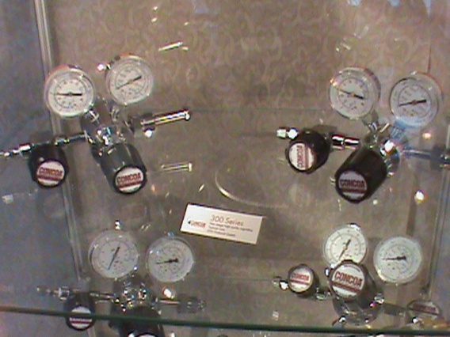
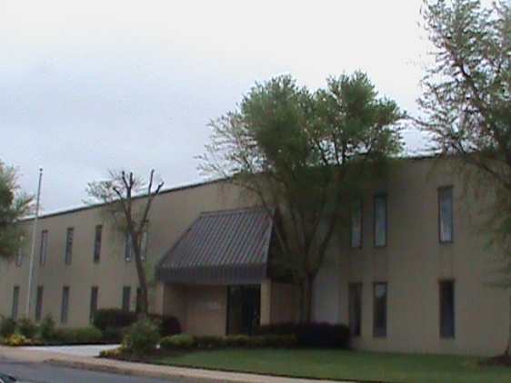
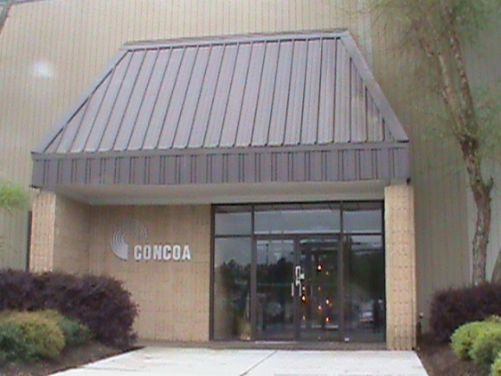
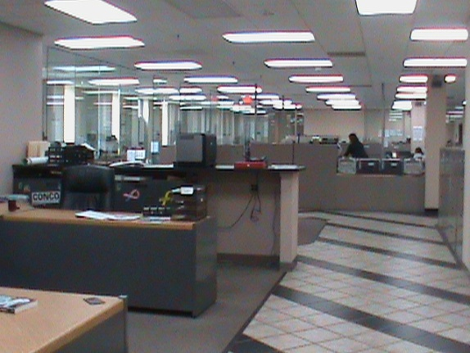
Internship
in Action.
Giorgio Valentini – Creative Marketing Specialist
Controls Corporation of America

Slide 12
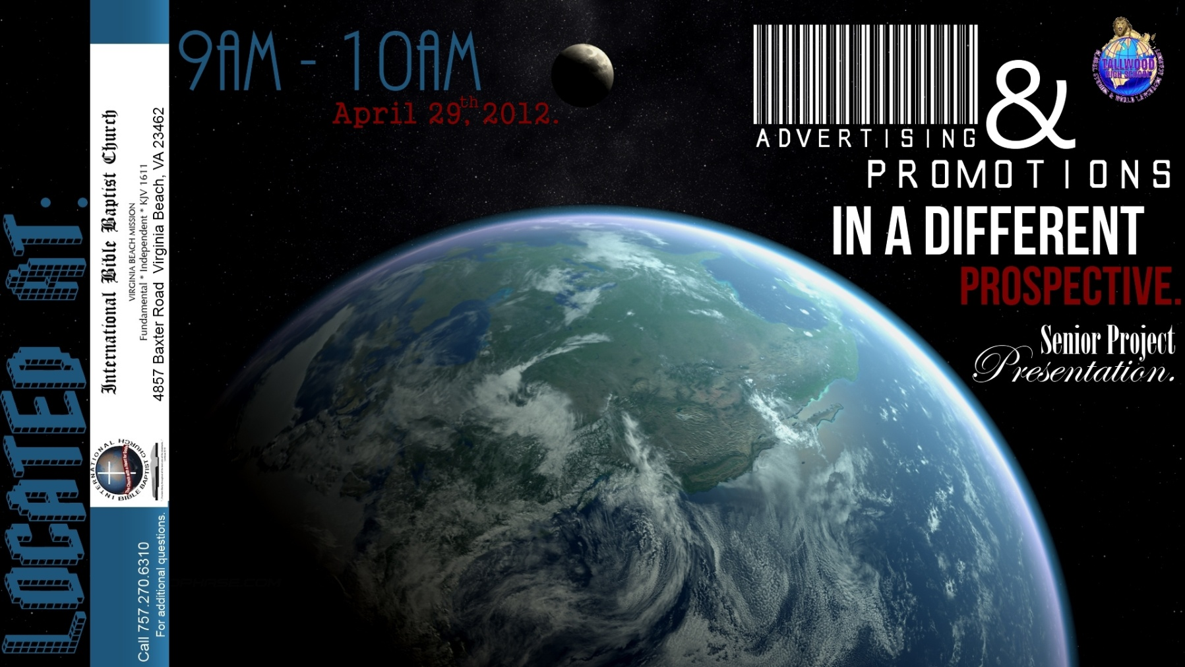
Event
in Action.
International Bible Baptist Church.
Project Presentation & Survey.

Slide 13
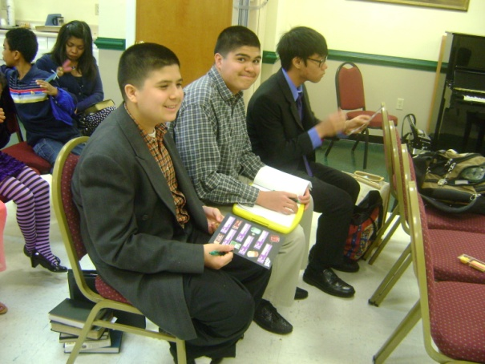
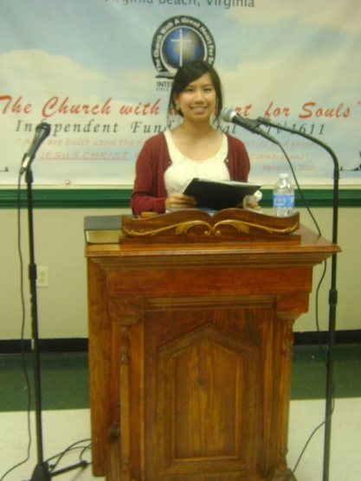
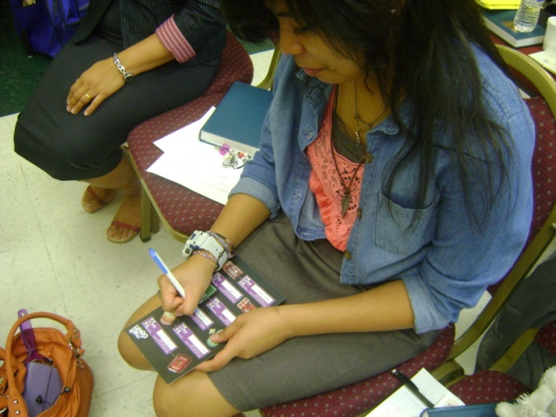
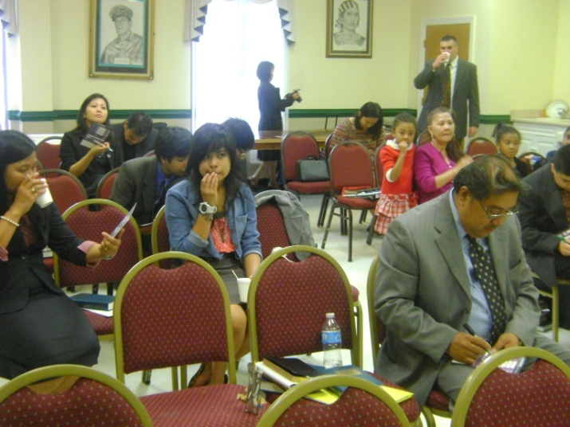
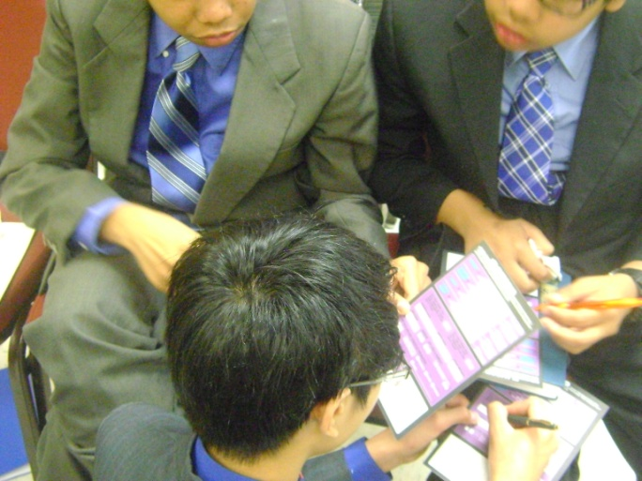
Event
in Action.

Slide 14
Citations
CIA. "North America: United States." The World Factbook. CIA, 2011. Web. 18 Dec. 2011. <https://www.cia.gov/library/publications/the-world-factbook/geos/us.html>.
Freidman, H. H. “Advertising, Publicity, and Sales Promotions.” brooklyn.cuny.edu. N.p., 2010. Web. 24 Jan. 2012. <http://academic.brooklyn.cuny.edu/economic/friedman/mmadvertising.htm
Holiday, Ruth, and Jo Elfving-Hwang. "Rethinking Atheistic Surgery in South Korea ." Appearance Matters Conference. 2010 ed. 2010. 8 Dec. 2011 PDF file pg.1.
Kim, Minjeong, and Angie Y. Chung. " Consuming Orientalism: Images of Asian/American Women in Multicultural Advertising." UMT. Qualitative Sociology, Vol. 28, No. 1, 2005. Web. 18 Dec. 2011. <http://www.umt.edu/sociology/faculty_staff/ellestad/documents/ 275_KimandChung2005_ConsumingOrientalism_s10.pdf>.
Steenkamp, Jan-Benedict E. M., et al. “ Competitive Reactions to Advertising and Promotion Attack.” Marketing Science; Informs. UCLA, Winter 2005. Web. 24 Jan. 2012. <http://www.anderson.ucla.edu/faculty/dominique.hanssens/content/CompetitiveReaction.pdf>.

